Slide 1
Execution Manager
Mohamed Saied

Slide 2
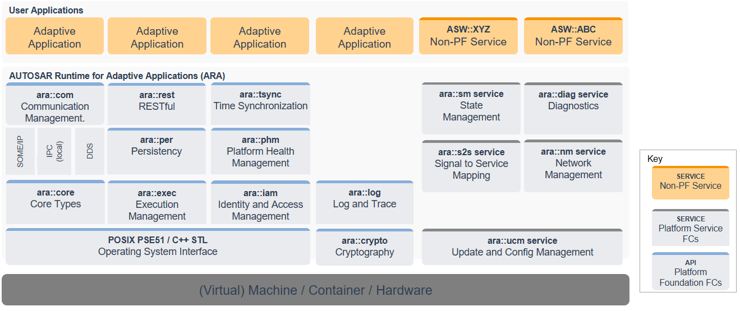
Architecture Overview
Logical view
*
*
*
*
*
*
*

Slide 3
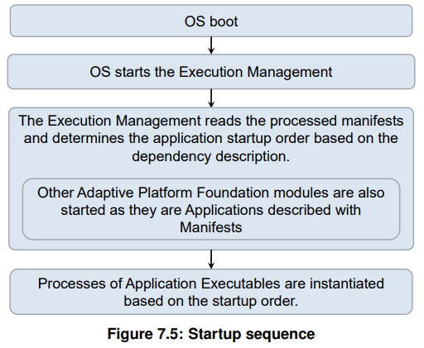
ara::exec
EM is responsible for:
Platform Lifecycle Management
Application Lifecycle Management
EM is not responsible for the run-time scheduling
Applications have to report to EM when the initialisation was completed by switching „running“ state
EM terminates applications using SIGTERM and applications have to report „terminating“ state

Slide 4
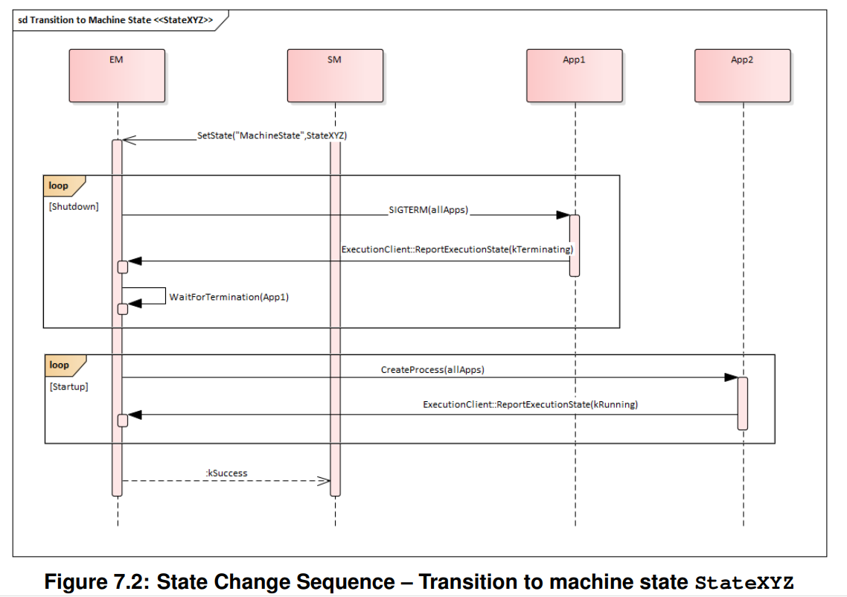
Startup/Shutdown sequence

Slide 5
App States
Initialized
Running
Shutdown

Slide 6
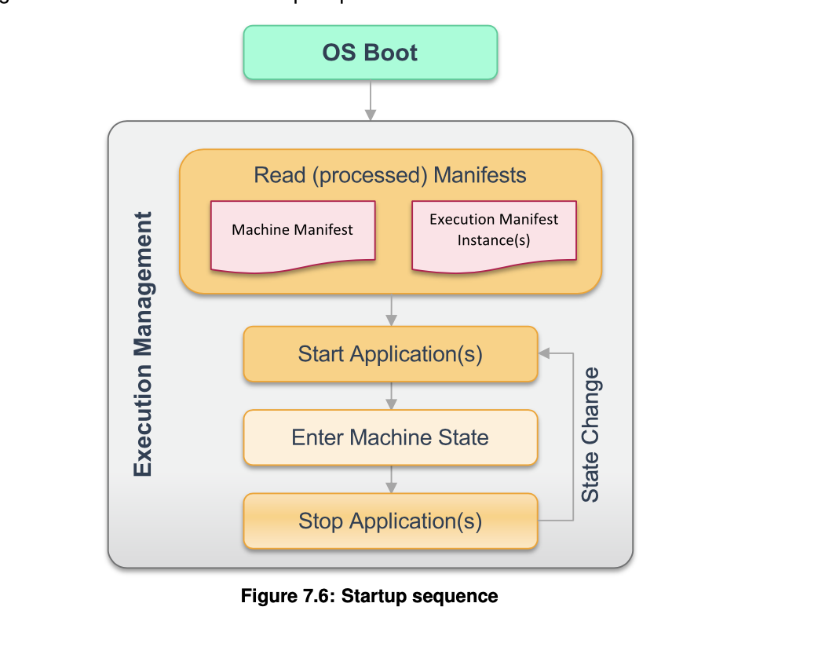
Machine start up sequence
EM -> EM initiates the Machine State : off state > start state (#1) -> EM reports Machine State Startup transition confirmation to State Management (#2)
(#1) During the transition, Execution Manage- ment requests startup of processes that exist in the Startup Machine State.
(#2) At that point, EM hands over responsibility for Function Group state management (i.e. initiation of state change requests) to State Management.
EM is not necessarily the first process launched, Other processes needed by the system may exist,
Please note that an Application consists of one or more Executables. There- fore to launch an Application, Execution Management starts processes as instances of each Executable.

Slide 7
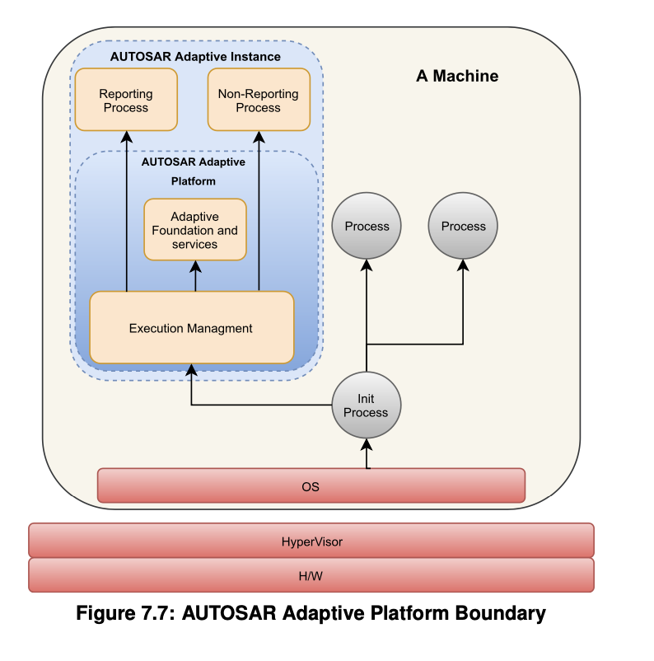
Platform boundary
How to end nm?
Execution Management is started as part of the AUTOSAR Adaptive Platform startup phase and is responsible for starting and terminating processes. -> so we can know that em will terminate nm

Slide 8
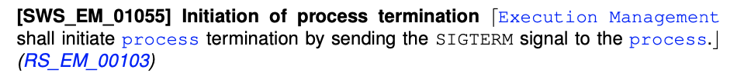
Termination
Execution Management does not perform standardized termination handling - the response to receipt of a signal, e.g. SIGTERM, by Execution Management is there- fore implementation defined.

Slide 9
Termination
Note that from the perspective of Execution Management, requirement [SWS_EM_01055] only requests the initiation of the steps necessary for grace- ful termination under the control of the process.
Execution ManagementmaysendSIGTERMatanytime,evenbeforetheprocess has reported kRunning state and thus the process is still in the Initializing Process State. On receipt of SIGTERM, a process simply commences the actual termination.-> we can terminate it any time
Terminating state target :
save persistent data
free all internally used resources
termination with exit status 0 (EXIT_SUCCESS)

Slide 10
EM as a parent process
EM as the parent process can help child process and take the appropriate platform-specific actions such as processing exe- cution dependencies that rely on the Terminated state and thus ensure that there is no overlap between these processes when both are running. -> but I think that we don’t need it because nm don’t rely on the others module

Slide 11
Another way of reporting
Execution Managementdifferentiatesbetweentwotypesofprocesses:Report- ing Processes and Non-reporting Processes. Reporting Processes are considered to be the normal form of processes and Non-reporting Processes are considered to be an exception.
Non-reporting Processes can be used to support running Executables which have not been designed with the AUTOSAR Adaptive Platform in mind. For example, if an Executable is available as binary only, if it is not feasible to patch its source code or if the Executable is only used during development time.

